Slide 1



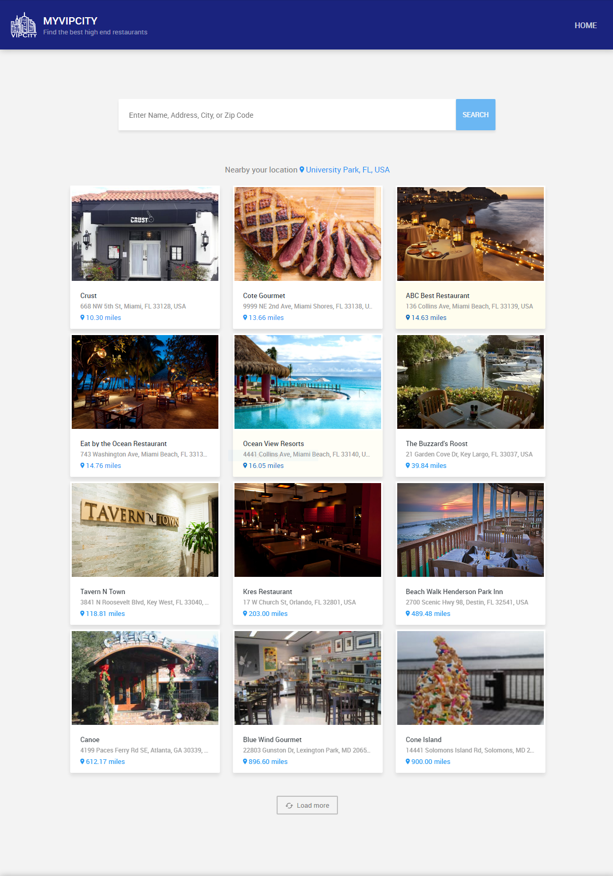
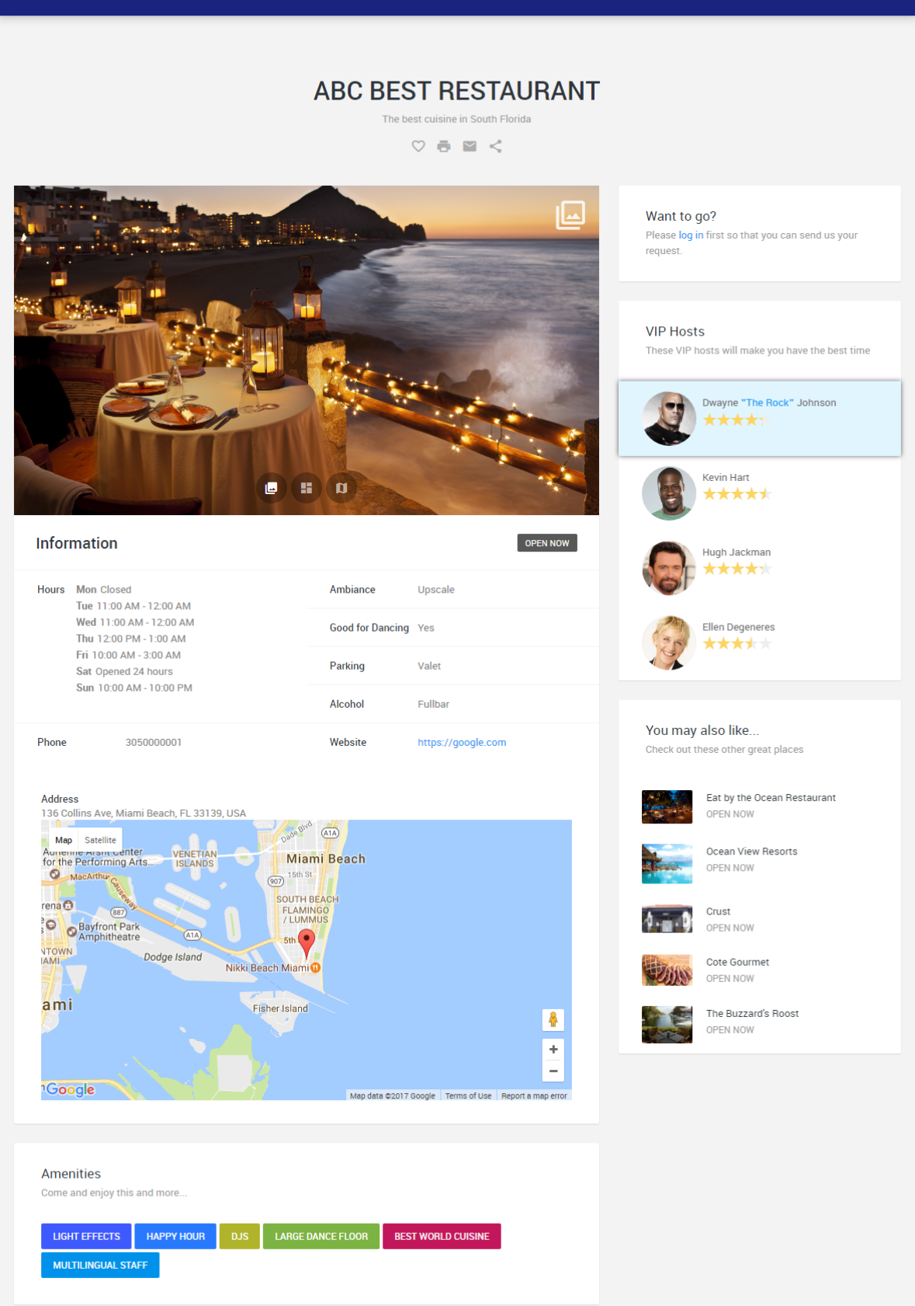
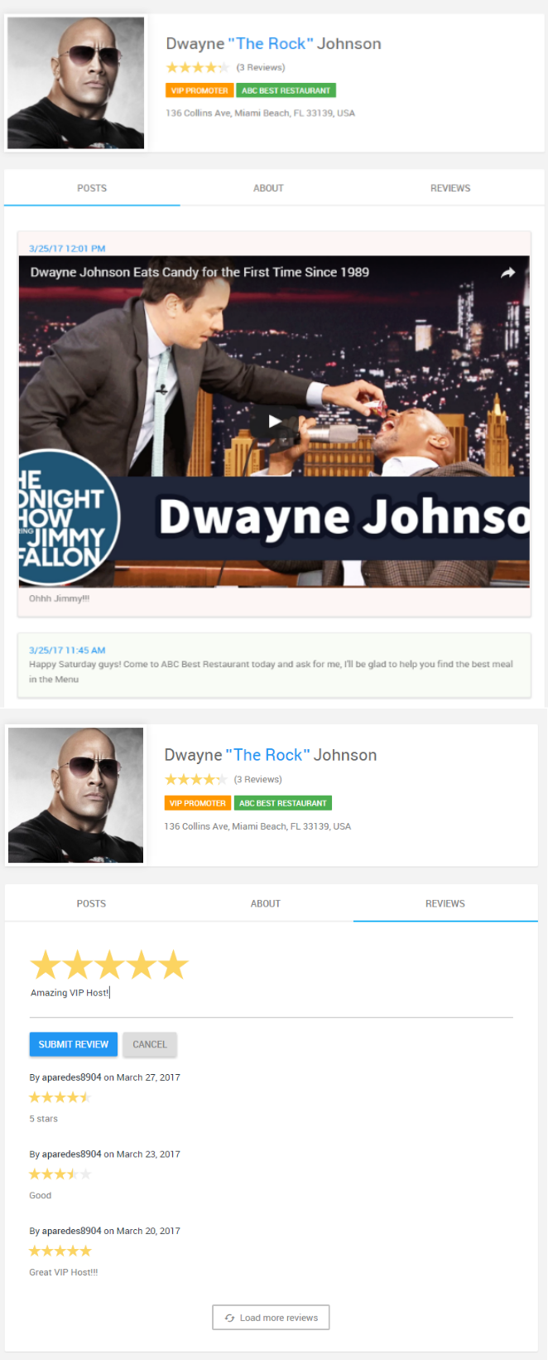
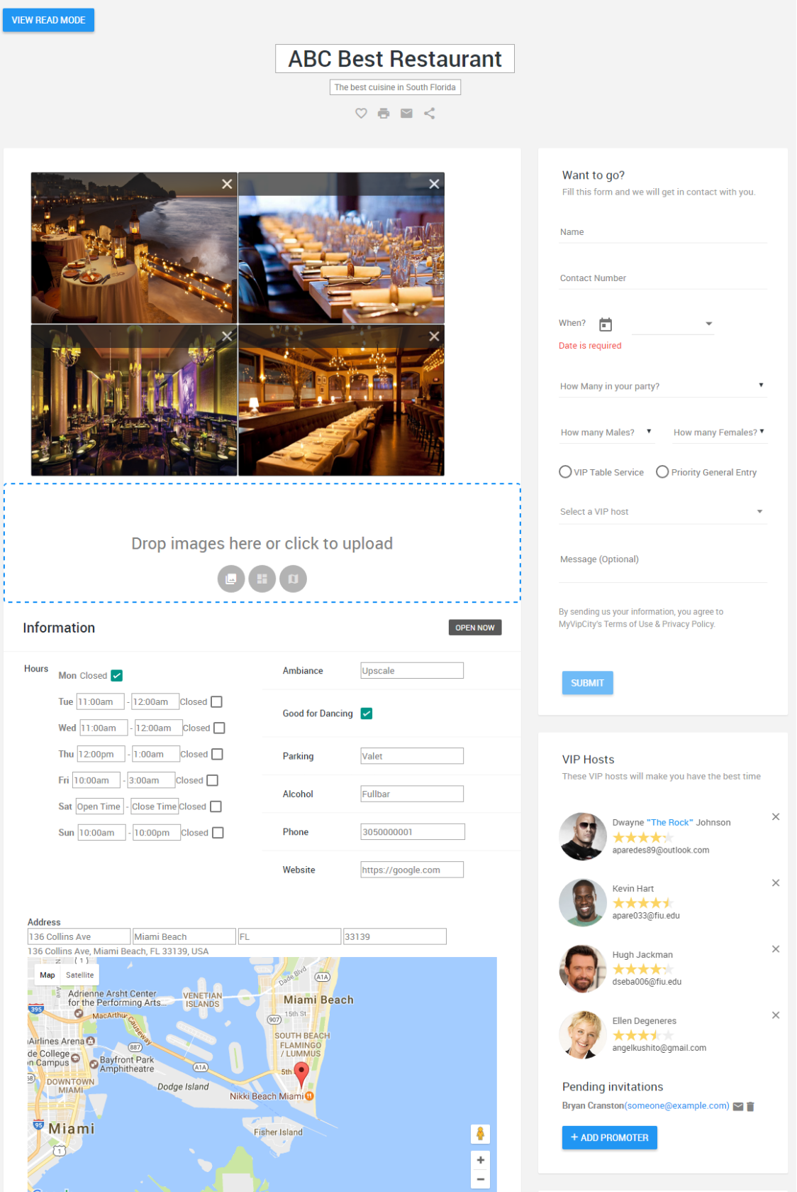
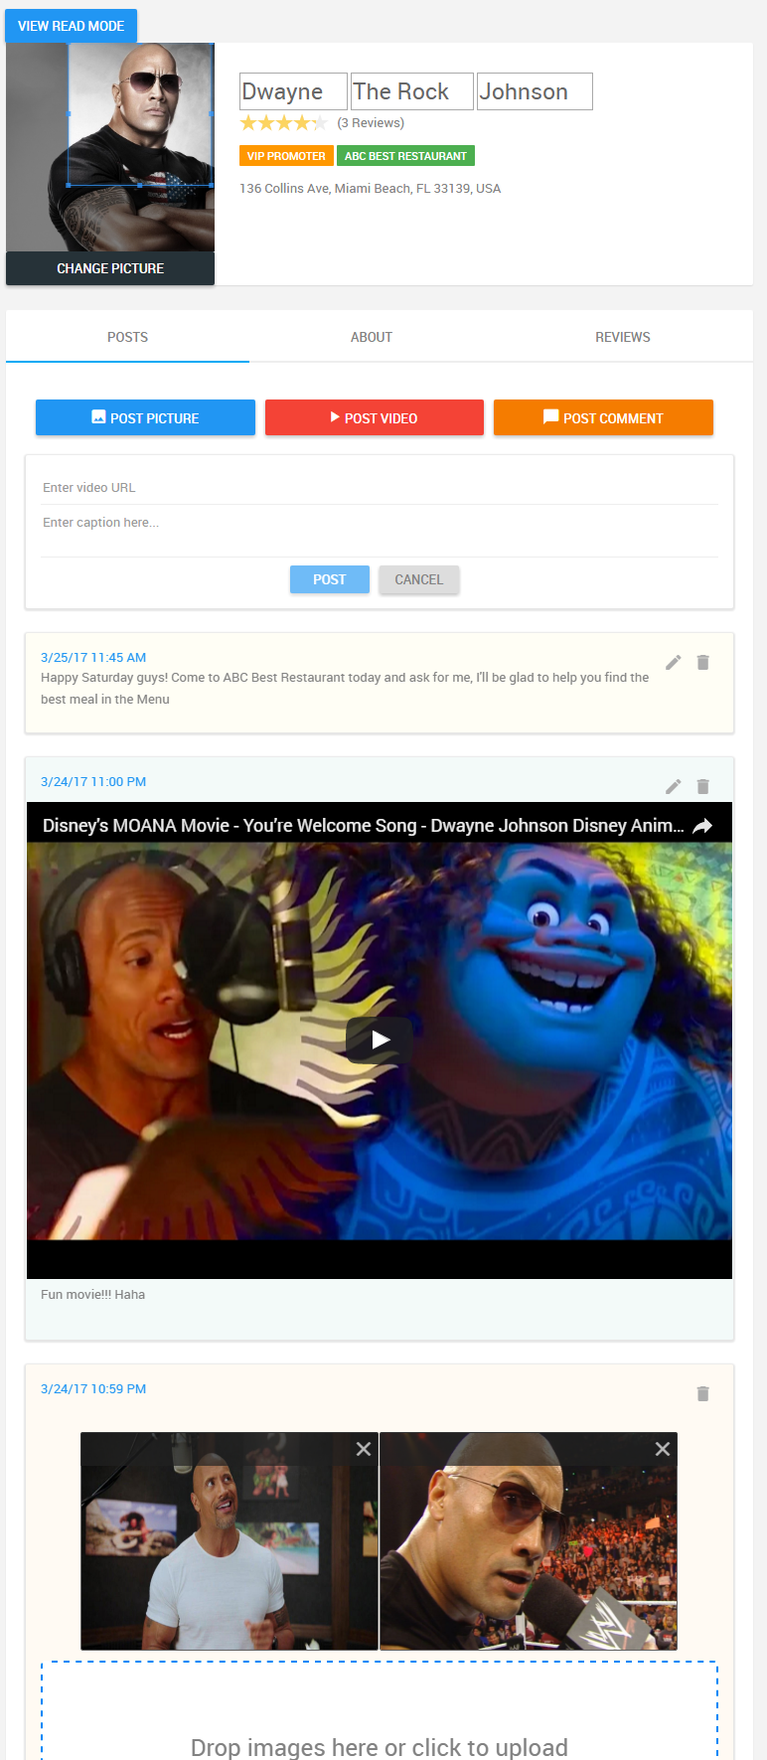
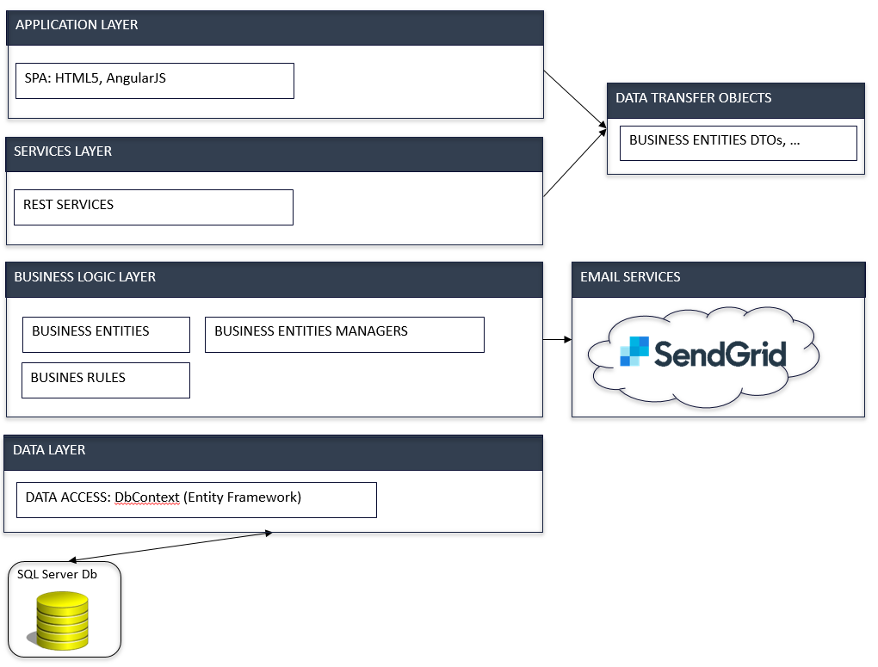
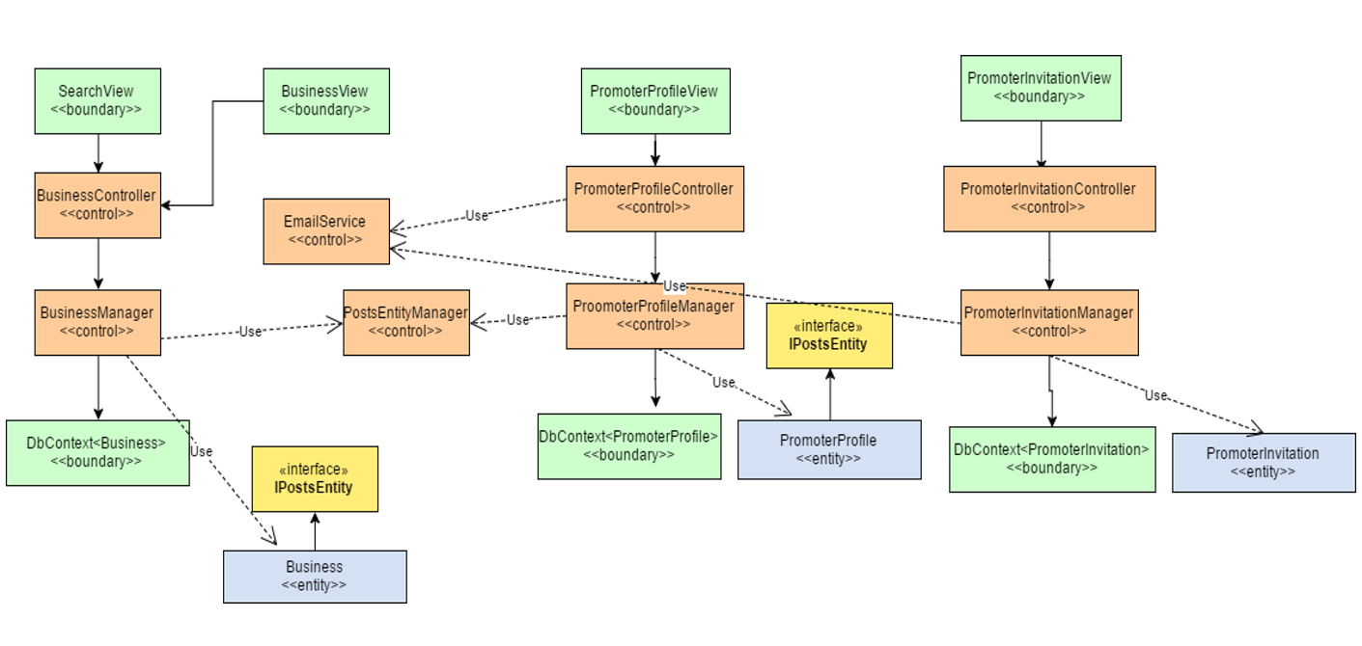














Senior Project, 2017, Spring
MyVIPCity 1.0
Student: Angel Paredes, Florida International University
Mentor: Mohsen Taheri, Florida International University
Instructor: Masoud Sadjadi, Florida International University
PROBLEM
SOLUTION
REQUIREMENTS
South Florida, being one of the most popular tourist destinations, does not have a centralized place where users can find information about high end restaurants and nightclubs. There are many visitors willing to pay a higher price to have a VIP experience in these places. Many times, these visitors want to use a VIP host, but they want to know more about the hosts before requesting their service.
MyVIPCity 1.0 is a portal (Single Page Application) that keeps a list of high end restaurants/clubs with the corresponding VIP Hosts.
Social oriented: each business and VIP Host have a profile page with basic information plus a social feed section to post comments, pictures and videos.
Rating system for VIP Hosts.
Easy searching functionality.
Results sorted by distance to user’s geographical location.
Users must be able to login with a created account, or with either Facebook or Gmail.
Admins can create/edit restaurants (add basic info i.e. address, name, etc.)
Admins can invite new VIP hosts for a specific restaurant/club.
VIP Hosts can accept invitations to join a restaurant/club.
VIP Hosts can have many profiles.
VIP Hosts and admins can posts comments, pictures and videos.
Users can add a review for VIP Hosts.
SCREENSHOTS
Home Page: Search functionality
Restaurant Profile
VIP Host Profile
Restaurant Profile - Edit
VIP Host Profile - Edit
SYSTEM DESIGN - ARCHITECTURE
OBJECT DESIGN
IMPLEMENTATION
Programming Languages: JavaScript, C#
Frameworks, Technologies and Services
SYSTEM DESIGN - DEPLOYMENT
VERIFICATION
SUMMARY
Purpose: Add a review to a VIP Host.
Preconditions: User is logged in, VIP Host profile opened and REVIEWS tab selected. Current Avg. Rating = 4, #Reviews = 1
Inputs: New review with 5 stars
Expected Result: New Avg. Rating = 4.5, #Reviews increased by one.
Actual Result: Avg. Rating = 4.5, #Reviews = 2
Test Result: Pass
MyVIPCity 1.0 keeps a portfolio of high end restaurants and VIP hosts, each having its own profile page.
The first version is a Single Page Application.
It offers an easy to consume REST API; therefore, future implementation of a phone app only needs to focus on UI.
Potential to add more amazing features.
The material presented in this poster is based upon the work supported by my mentor Mohsen Taheri. I am thankful to the help that I received from the Product Owners of this project: Ali Aliabadi, Arash Shivazad and Hamid-reza Nazemi, as well as from my teammate Darshana Sebastian, mentor Mohsen Taheri and instructor Masoud Sadjadi. Special thanks to my family for all the support.

